Slide 1
Reality Check of Metaverse: A First Look at Commercial Social Virtual Reality Platforms
Ruizhi Cheng, Nan Wu, Songqing Chen, and Bo Han
George Mason University
Email: rcheng4@gmu.edu

Slide 2
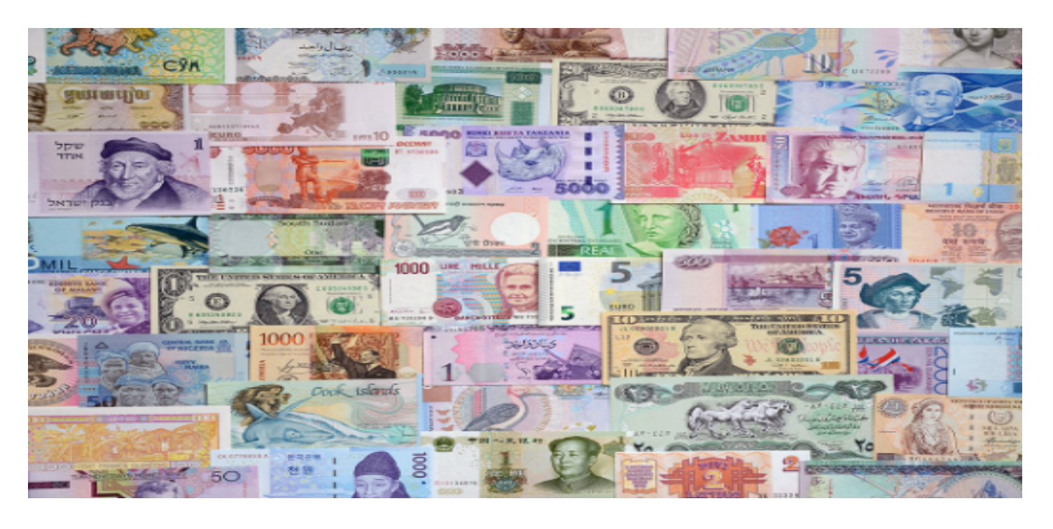

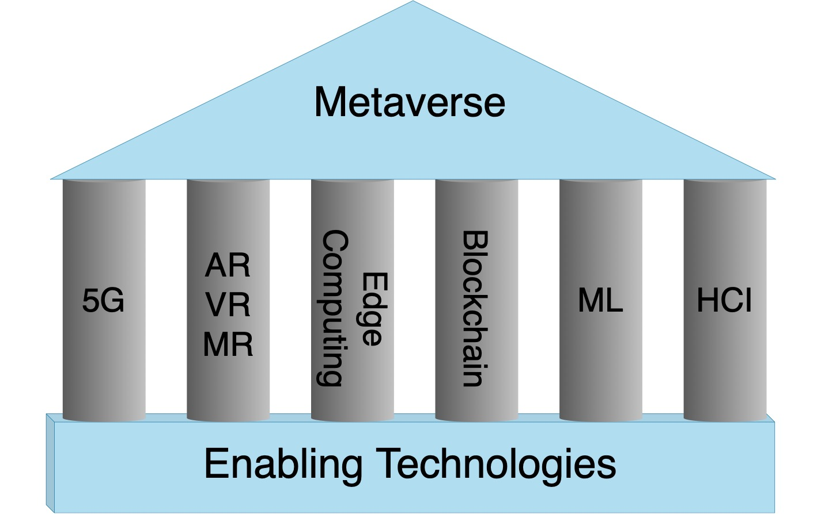
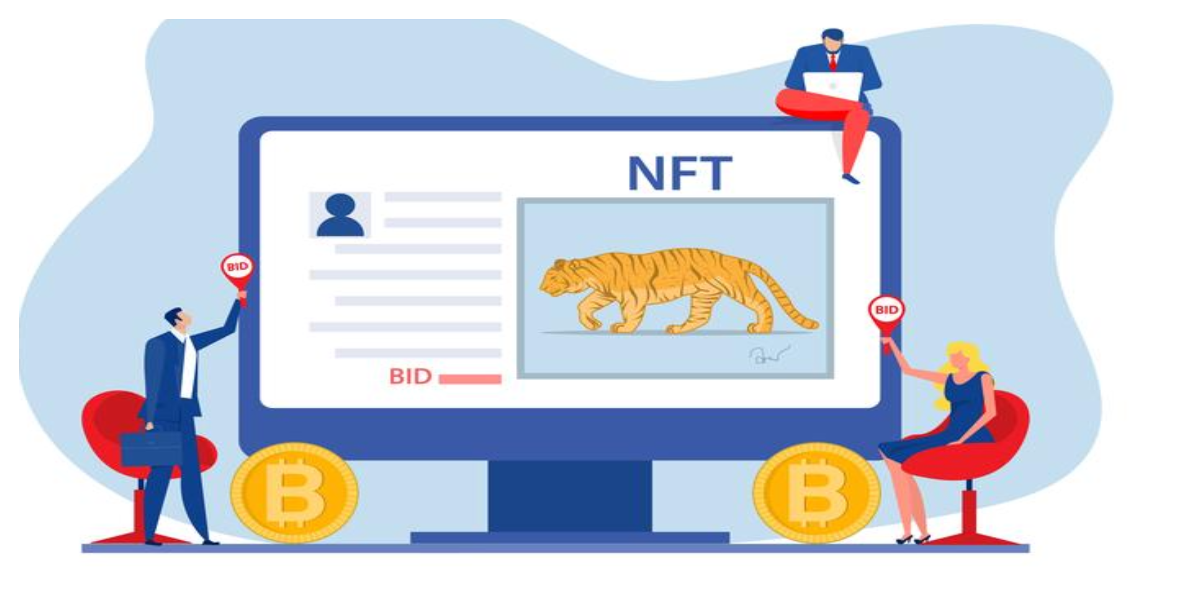
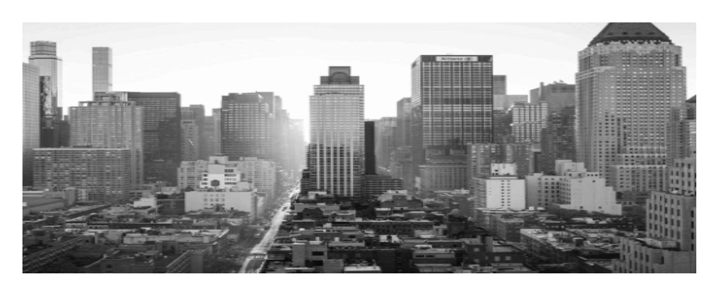
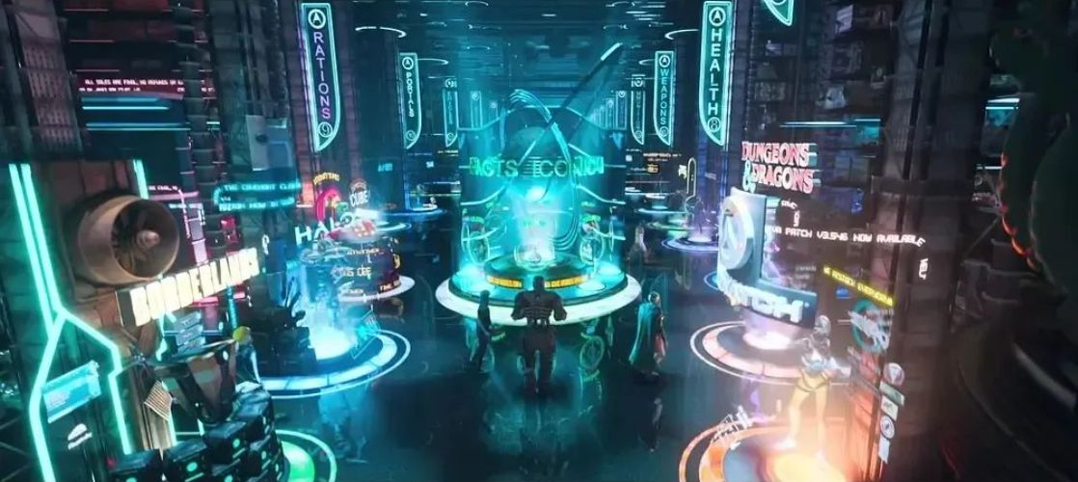
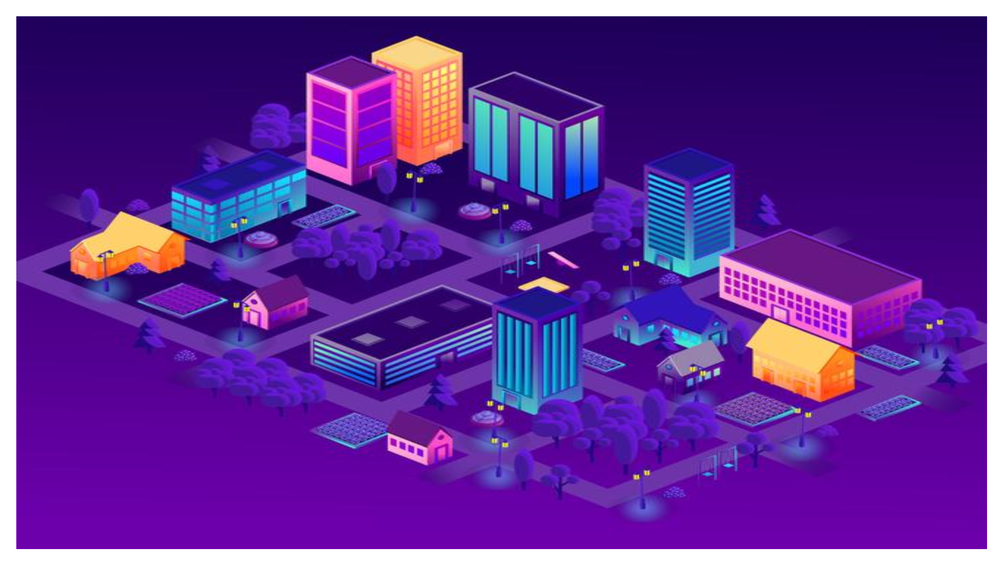
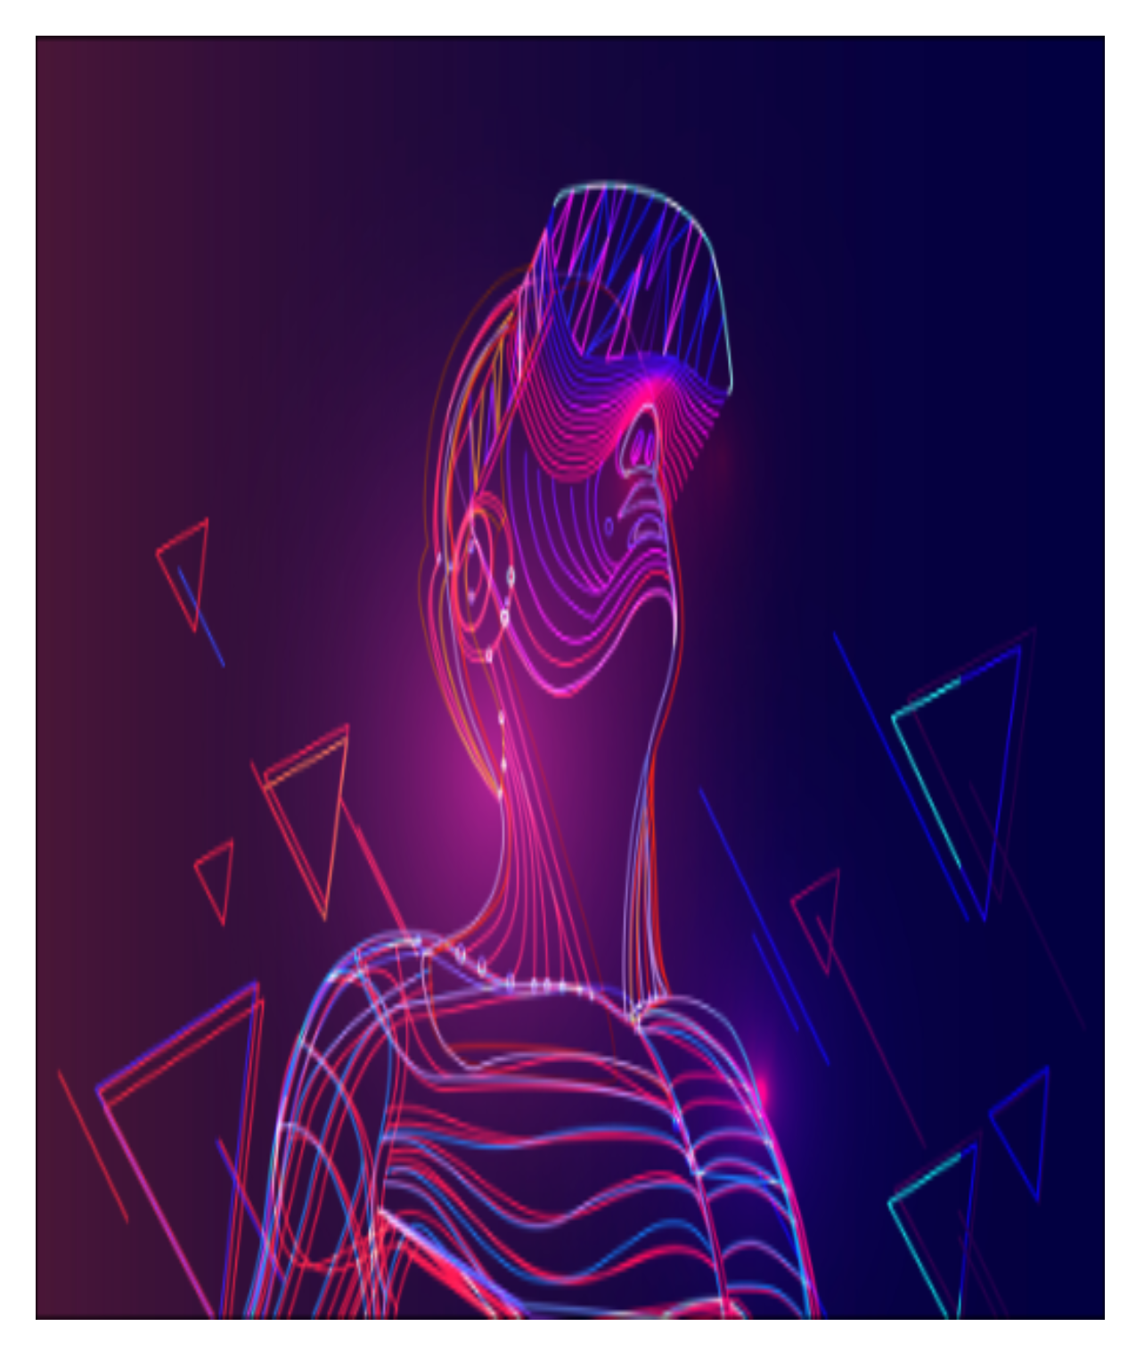
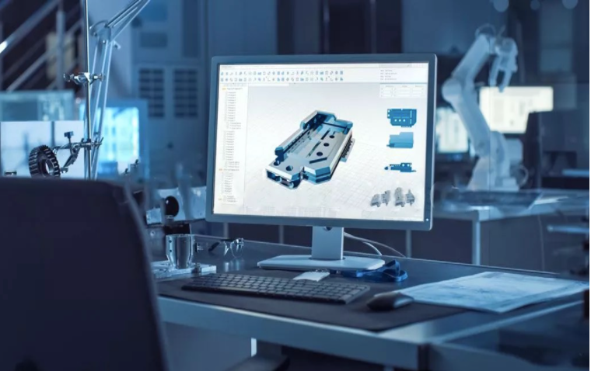
Metaverse
A collection of 3D virtual worlds connected via the Internet and XR^{[1]}.
Real-world
Currency
Real-world
Objects
Physical
World
XR
AI
Non-fungible Token
Blockchain
Digital
Twins
Metaverse
Trade
Decorate
Social Events
User-generated Content
XR
5G, HCI
Enabling Technologies of the Metaverse.
XR Devices
3D Modeling
Elements of the Metaverse and their interaction with the physical world.
[1] Ruizhi Cheng, Nan Wu, Songqing Chen, and Bo Han. Will Metaverse be NextG Internet? Vision, Hype, and Reality. https://arxiv.org/abs/2201.12894, 2022.
Notes:
While the term “Metaverse” has been coined for 30 years, there is still no unified definition of the metaverse.
In the current stage, with the flourishing of 5G and immersive computing [5], we believe that the metaverse will become a collection of 3D virtual worlds connected through the Internet and XR.
1.The Metaverse we envision is composed of four parts, and they are closely connected to the real world.
2.In general, users with XR devices can access the Metaverse and participate in its various social events, and they can create their own content via 3D modeling to decorate social events in the Metaverse.
3.The content can be traded using non-fungible token through a decentralized blockchain.
4.Objects in the physical world can also be presented in the Metaverse as digital twins that are generated via 3D modeling.
5.As we can see the metaverse will be built via multiple technologies, such as 5G, XR and edge computing.
Our research mainly focuses on the network demands of the metaverse.

Slide 3
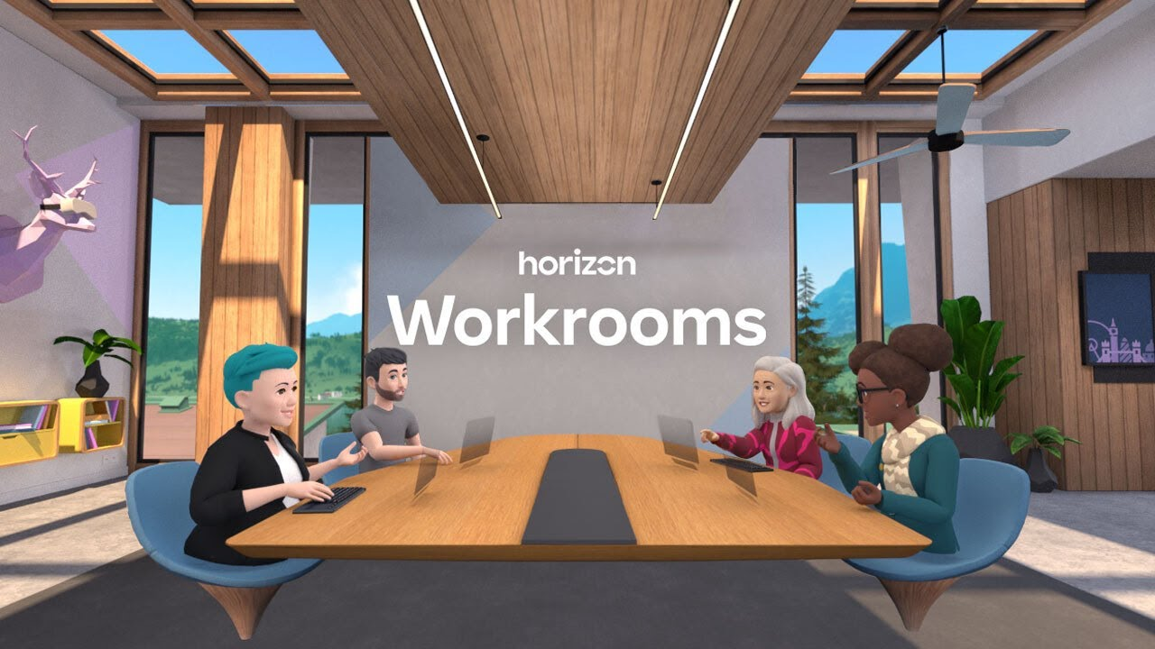
Social VR
Background
Social Media + VR System.
A major component of Metaverse.
Challenge
Need to transmit Social VR content in real-time.
Need to deliver high-quality fps and resolution content consistently.
Bandwidth consumption may be high.
Current Solution in the Industry
Design the background and user-generated content (UGC) as static content.
Only transmit Avatar’s interaction in real-time.
Render content in local.
Notes:
1.In our paper, we focus on an important component of the metaverse: social VR.
social VR can be considered as a combination of social media and VR systems.
2.In social VR applications, servers need to deliver high-quality social VR content in real time, which might bring huge bandwidth consumption.
3.Based on our measurement study on several platforms, we concluded the current solutions to this problem in the industry.
First of all these platforms treat virtual backgrounds and UGC as static content, and only transmit Avatar interaction data in real time.
Then these platforms all use local rendering approaches instead of remote rendering, so that these platforms only need to transmit Avatar location information instead of high-quality video streams.
In this paper, we focus on Meta's Horizon Workrooms platform, a social VR platform mainly used for online meetings.

Slide 4
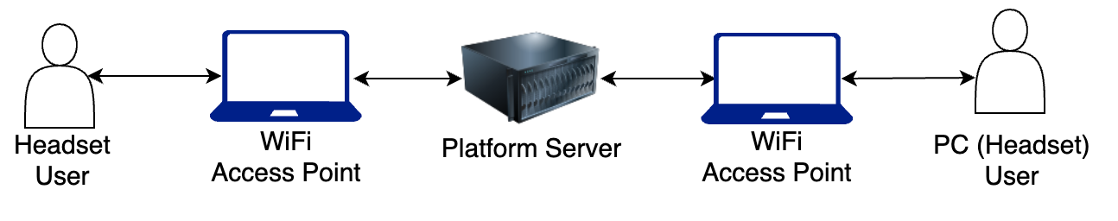
Experiment setup
Two users. One user uses Quest 2 and the other one uses PC or Quest 2.
Enable and disable one feature for each experiment.
Notes:
1.Our experiment has two users, one user using the Oculus Quest 2 VR headset and the other user using a PC or a headset.
The two users are connected to different local area networks.
2.To measure the network impact of each feature of the platform, we only enable and disable the same feature in each experiment.

Slide 5


Protocol Analysis in Workrooms and AltspaceVR
Workrooms: two servers. One for virtual content (VC flow) and another for multimedia content (MM flow).
AltspaceVR: two servers. One for virtual content and another for user-related content.
PC
User
Headset
User
PC
User
Headset
User
Server I
Server II
Server I
Server II
PC Users do not exchange virtual content with Server I
Stage I for headset users: Server I loads background and keeps exchanging virtual content via UDP.
UDP
Stage I: Both users set up HTTPS (over TCP) connection with Server I, then load main environment and world content of the event from Server I via HTTPS.
1
HTTPS
1
HTTPS
Stage II for browser users: Users set up a connection with Server II via TCP, DTLS (over UDP), and STUN.
Stage II for headset users: Users set up a connection with Server II via TLS (over TCP) and STUN.
TLS
DTLS
STUN
TLS
STUN
2
Stage II: Both users keep exchanging user-related content (e.g., audio) with Server II via UDP.
UDP
2
UDP
RTP
RTCP
Stage III for browser and headset users: Users keep exchanging multimedia content with Server II via RTP and RTCP.
RTP
RTCP
3
The process of establishing connections and exchanging
data between the clients and the servers in Workrooms.
The process of establishing connections and exchanging
data between the clients and the servers in AltspaceVR.

Slide 6
Protocol and Capacity of Social VR Platforms
Both UDP and HTTPS (over TCP) can be used for the initial setup.
All platforms download and render the static virtual background from the server.
Most platforms use UDP to transmit avatar interactions in real-time.
Social VR platform can support more than 15 VR users in the same environment.
Platform | Welcome Page (Single User) | Social Event |  | Max Users in One Room
 |  | Virtual Background | User Interaction
RecRoom | UDP | Pre-download in the App | UDP | 40
VRChat | HTTPS | HTTPS Downloading (first joining) | UDP | 40
Mozilla Hubs | HTTPS | HTTPS (everytime) | Audio: RTP/RTCP (over UDP) Others: HTTPS | 24
Horizon Worlds | UDP | Pre-download in the App | UDP | 20 (Headset)
Horizon Workrooms | HTTPS | UDP | Audio: RTP/RTCP (over UDP) Others: UDP | 16 (Headset) 50 (Total)
AltspaceVR | HTTPS | HTTPS Downloading (first joining) | UDP | 50
Notes:
Next, we outline the network protocols used by the six commercial social VR platforms and their capacities.
1.First, both UDP and TCP protocols can be used for intial setup.
2.Second, while after the user enters a social event, the user downloads and renders a static background from the server, and then most platforms use UDP to transfer user interaction data.
3.Finally, we found that all current social VR platforms can support more than 15 VR users in the same environment.

Slide 7
Bandwidth Requirement
The amount of data transferred between Avatars is not related to Avatar motion trajectories.
Avatar interaction in Meta‘s Social VR platforms consumes 10X bandwidth of other platforms.
Bandwidth consumption of Avatar may be related to the complexity of the Avatar model.
Symmetrical uplink and downlink throughput for two VR users in most platforms.
Platform | Bandwidth (two Quest 2 users)
 | Uplink | Downlink
Horizon Workrooms | 0.5 Mbps (virtual content flow) | 2.3 Mbps (virtual content flow : 0.6 Mbps; multimedia flow: 1.7 Mbps)
Horizon Worlds | 0.7 Mbps | 0.4 Mbps
AltspaceVR | 0.04 Mbps | 0.04 Mbps
RecRoom | 0.05 Mbps | 0.05 Mbps
VRChat | 0.03 Mbps | 0.03 Mbps
Mozilla Hubs | 0.06 Mbps | 0.06 Mbps
Notes:
We first measured the throughput requirement of six social VR platforms with two Quest 2 users.
1.We found that Avatar's motion trajectory does not affect the amount of data transmitted, which may indicate that these platforms update Avatar's location in real-time.
2.We also observed that Meta's social VR platforms have more than ten times of the throughput compared to other platforms.
3.By exploring further, we speculate that this may be because Meta's Avatar model is more complex than the other platforms.
4.Finally, we observe that the user uplink and downlink throughputs are symmetric for most platforms when the platform has only two Quest 2 users.
The essential reason for this phenomenon is the local rendering strategy, which I will introduce when I discuss the scalability issues of these platforms.

Slide 8
Virtual Content Flow in Workrooms
Confirm this flow’s transmitted content by enabling functions related to virtual content.
Downlink = virtual background (0.1 Mbps) + the other Quest 2 avatar’s information (0.5 Mbps)?
Bitrate of the Quest 2 user when the other user uses Quest 2.
Bitrate of the Quest 2 user when the other user uses PC.
Notes:
Let's now dive into Workrooms.
first we analyze the Virutal Content Flow in Workrooms.
we determined the content transmitted in this flow by enabling some features related to virtual content.
1.We notice that for a Quest 2 user, when another user is a PC user, its uplink does not change significantly while downlink drops from 0.6 Mbps to 0.1 Mbps compared to the case when another user is a Quest 2 user.
and this 0.5 Mbps is equal to the uplink of a Quest 2 user.
We therefore suspect that the downlink throughput of a Quest 2 user can be divided to the virtual background throughput and the uplink throughput of the Quest 2 users.

Slide 9
Scalability Issue in Workrooms
Let the other three headset users join the room every 50 seconds.
Downlink throughput grows linearly with the addition of new headset users.
No viewport prediction.
Other platforms also have scalability issues.
The cause of Scalability Issues is local rendering.
Bitrate of the VC flow for one of the Quest 2 users. U3, U4, and U5 join the meeting at 50, 100, and 150 s respectively.
Notes:
So we do the experiment where we let three other headset users join the room every 50 seconds.
1.We find that the downlink throughput of users grows linearly with the addition of new headset users by exactly 0.5 Mbps.
This indicates that Workrooms faces the scalability issue.
2.We also find that the downlink throughput of users does not decrease when there are no other avatars in the user viewport, which indicates that Workrooms does not do viewport prediction.
Instead, it just transmits all 6-DoF data to the user's headset.
3. In our experiments in other platforms, we find that all platforms face scalability issues.
4.The essential reason of this problem is the local rendering strategy that the server only transmits the location information of all other users to a user, which leads to a linear increase in user downlink throughput as new users join. we believe that this problem is one of the urgent problems in building the Metaverse at present.

Slide 10
Multimedia Flow in Workrooms
Use WebRTC technology to deliver audio and video data.
Audio: two sessions. One for sending and the other one for receiving.
Video: two sessions. All from downlink.
PC users and Headset users receive the same video data.
The video data of the headset user is unclear.
Bitrate of the audio sessions (both users mute from 100 to 150 s) in Workrooms.
Bitrate of the two video session in Workrooms
Notes:
Next we analyze the multimedia flow of Workrooms.
This flow uses WebRTC to transfer audio and video data.
1.Each user has two audio sessions, one for uploading their own audio data and the other for receiving audio data from another user.
2.Each user also has two video sessions, but all video sessions are downlink data.
3.Also we observe that the video data received by the PC user and the Headset user are the same because their SSRC fields in the RTP packets are the same.
4.The source of the video for the PC user may be the 2D scene it sees, since it does not transfer data with the virtual content server, but the source of the video data to the Headset user is unknown.

Slide 11
Advanced Feature in Workrooms
Virtual Whiteboard
Users can use their controllers as a pen.
Use virtual content flow to transmit data.
Share PC Screen
WebRTC technology (new multimedia flow).
The two video sessions disappear when sharing the screen.
Bitrate of the VC flow. Enable virtual whiteboard from 150 – 170 s.
Bitrate of the MM flow. Share screen twice staring at 80 and 140 s, respectively.
Notes:
Next we explored some of the advanced features of Workrooms.
1.First Quest 2 users can share a virtual whiteboard in Workrooms, and then users can write on it using the controllers as a pen.
We find that Workrooms uses the virtual content flow to transfer the whiteboard data.
2. Quest 2 users can also share their PC screens in the room.
We found that the screen sharing feature creates a new multimedia flow. surprisingly, when a Quest 2 user shares the PC screen, the user's original two downlink video sessions disappear, but the user's headset screen does not show any anomalies at this time.
Therefore, we speculate that the video data of the Quest 2 user may be redundant. This may be an implementation bug of Workrooms.

Slide 12
Concluding Remarks
Key Observation
Social VR platforms consider virtual backgrounds and UGC as static content and only transmit Avatar interaction data.
Social VR platforms currently use the local rendering approach, but it faces scalability issues.
There is still a lot of room for optimizing the data transmission of Avatar interaction.
Future Work
Measure network requirements of different VR devices.
An automated tool that can measure the end-to-end latency of social VR platforms in different geographical locations.
Explore ways to optimize the data transferred in the Social VR system.
Notes:
1.In conclusion, we find that current social VR platforms only transmit Avatar interaction data in real-time and use local rendering approach.
However, this approach poses scalability issues.
We also observe that there is still a lot of room to optimize the Avatar interaction data transmitting.
2.In future work, we plan to explore the network requirements of the Social VR platform for different VR headsets.
And propose an open-source automated tool that can measure the end-to-end latency of the Social VR platform in different geographical locations.
Finally, we will explore ways to optimize the data transferred in the Social VR system.

